Slide 1

Final Presentation
VipraHub

Slide 2
Objective:
Our objective is to design an open source application with maximum features which promote users to do reproducible research, manage all their models at one place. Moreover, this will also provide great visualization and exposure of contributor’s work.
2

Slide 3
PREJECT JOURNEY
Wireframes
Implemented Home Page
Dashboard
Login and Registration
INCREMENT-1
Jan 29th,2019
1
Feb 25th,2019
Start
Download Model from File System
Advanced search for Model
View Model
UI level Enhancements
Model Repository
2
Mar 18th,2019
Upload Model to Mongo and File System
Search , Filter and Sorting of Model
Enhancements of Increment-1 features
Bug Fixes
April 18th,2019
INCREMENT-3
3
VipraHub
INCREMENT-2
Feb 15th 2019 to
May 7th 2019
Download Model from MongoDB
Experiment Rating and Comments
Meta Data Extraction from MongoDB
Testing and Bug Fixing
Deployed application in Heroku
Upcoming features
May 06th,2019
4
X
XX
Presentation on May 07th,2019
INCREMENT-4
Journey Continues…..

Slide 4
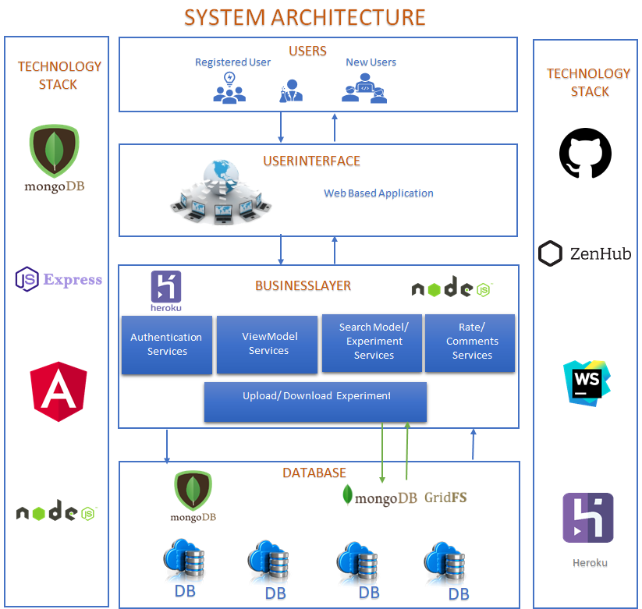
System Architecture

Slide 5
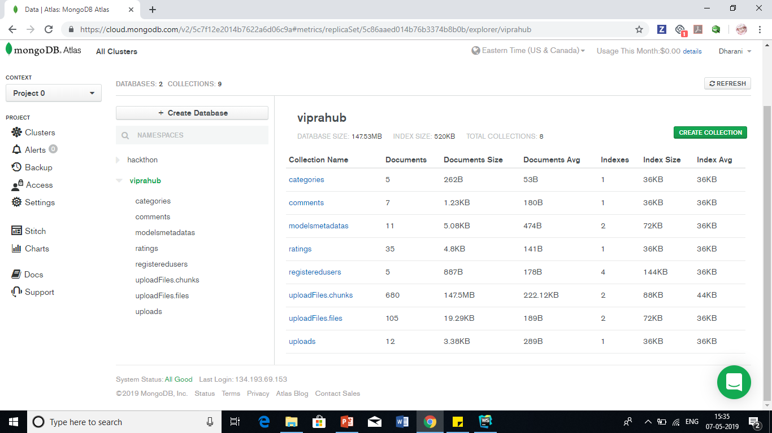

Slide 6
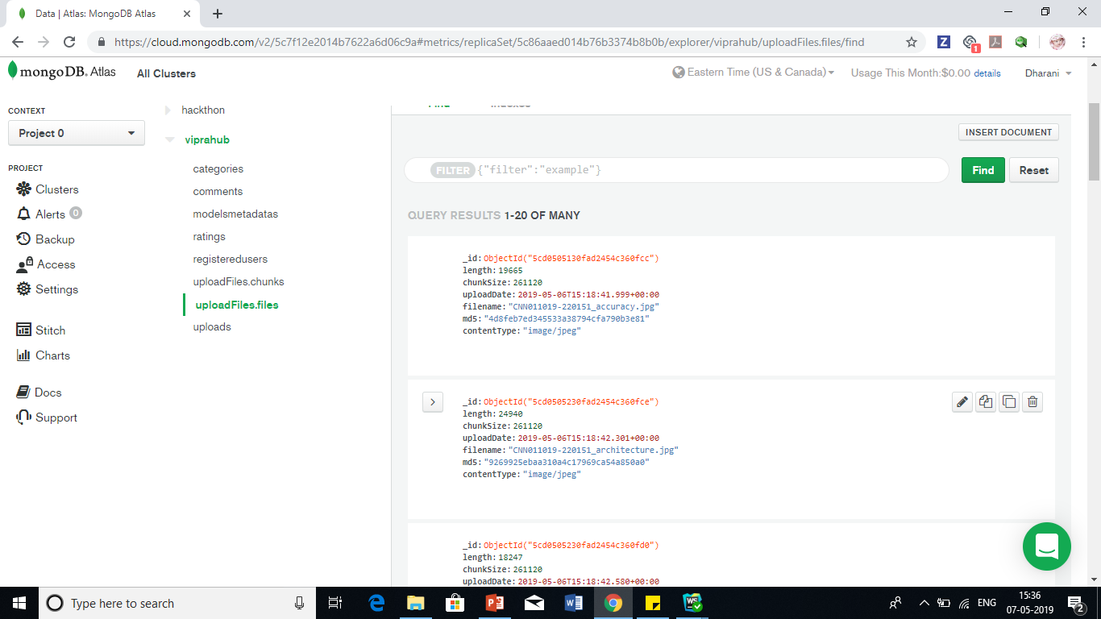

Slide 7
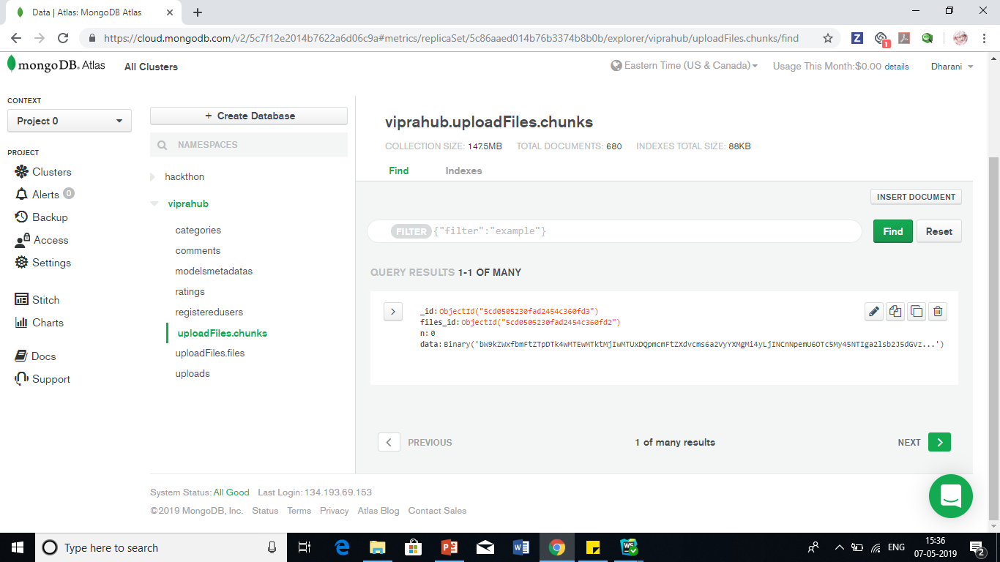

Slide 8
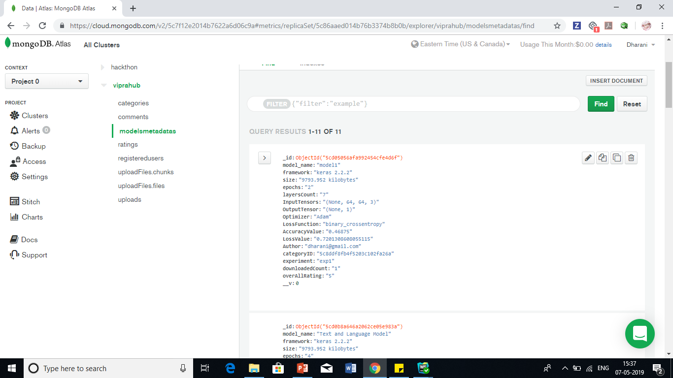

Slide 9
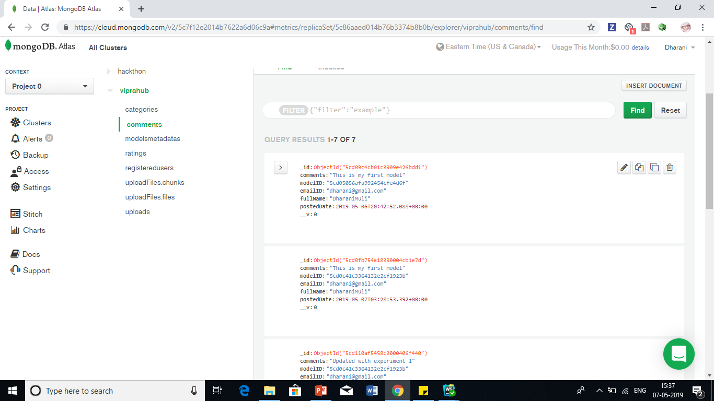

Slide 10
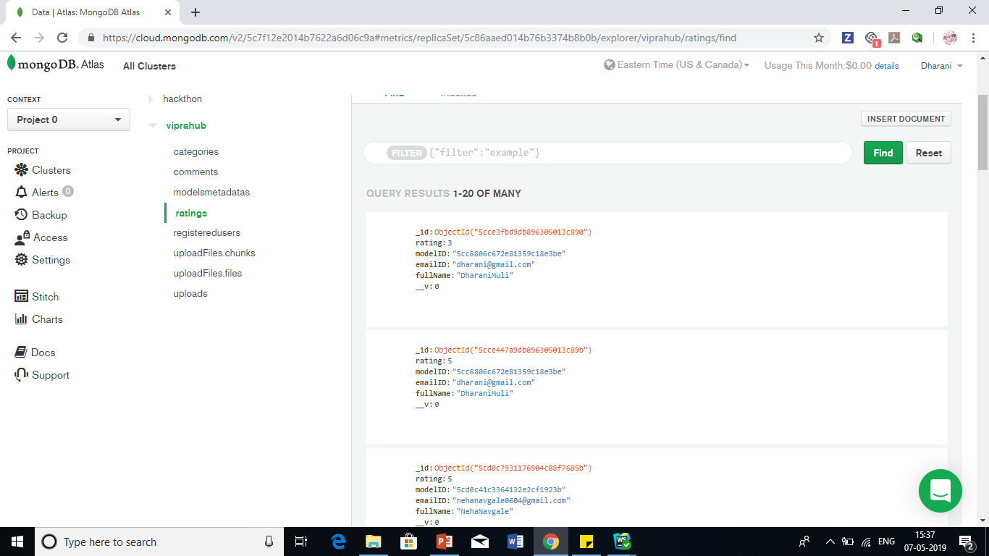

Slide 11
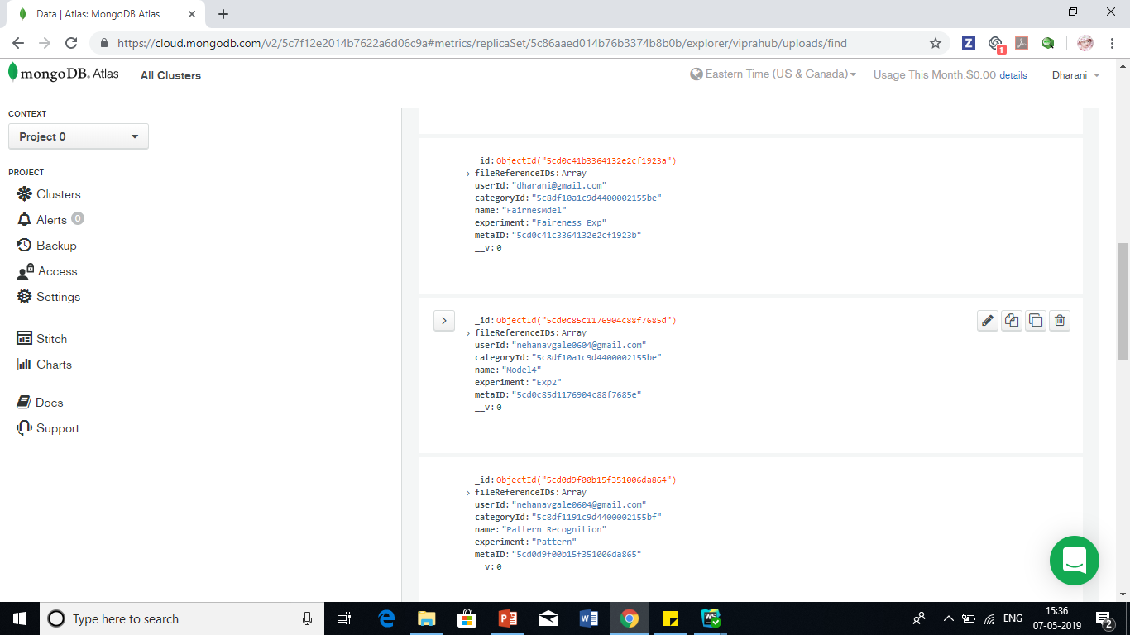

Slide 12
Demo
Application- VipraHub

Slide 13
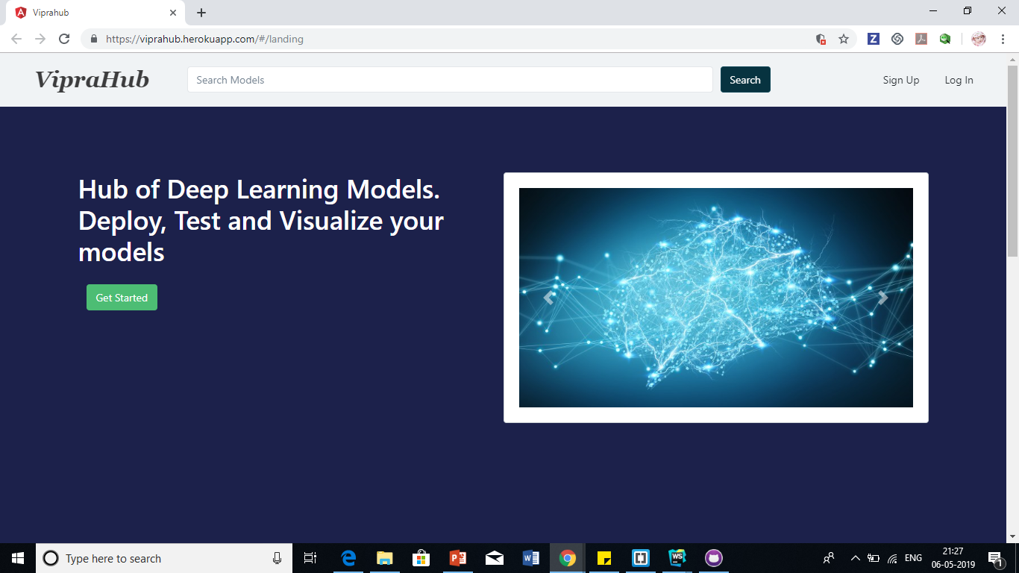
Home Page

Slide 14
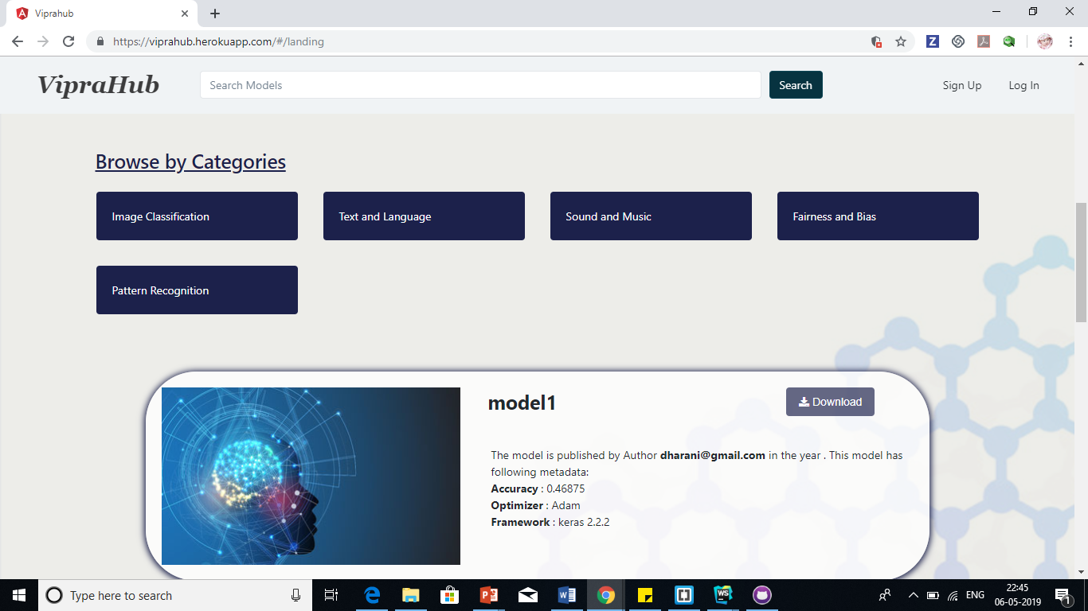
Home Page

Slide 15
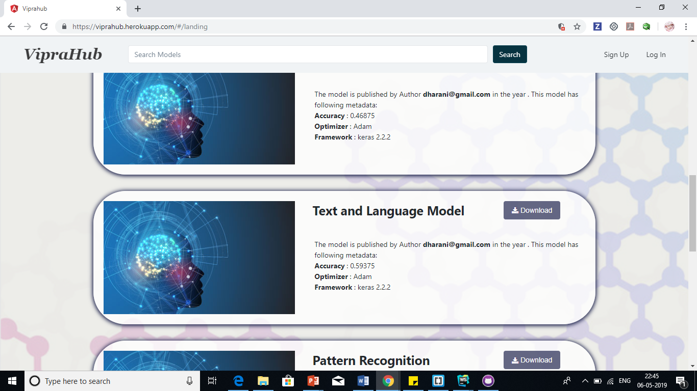
Home Page

Slide 16
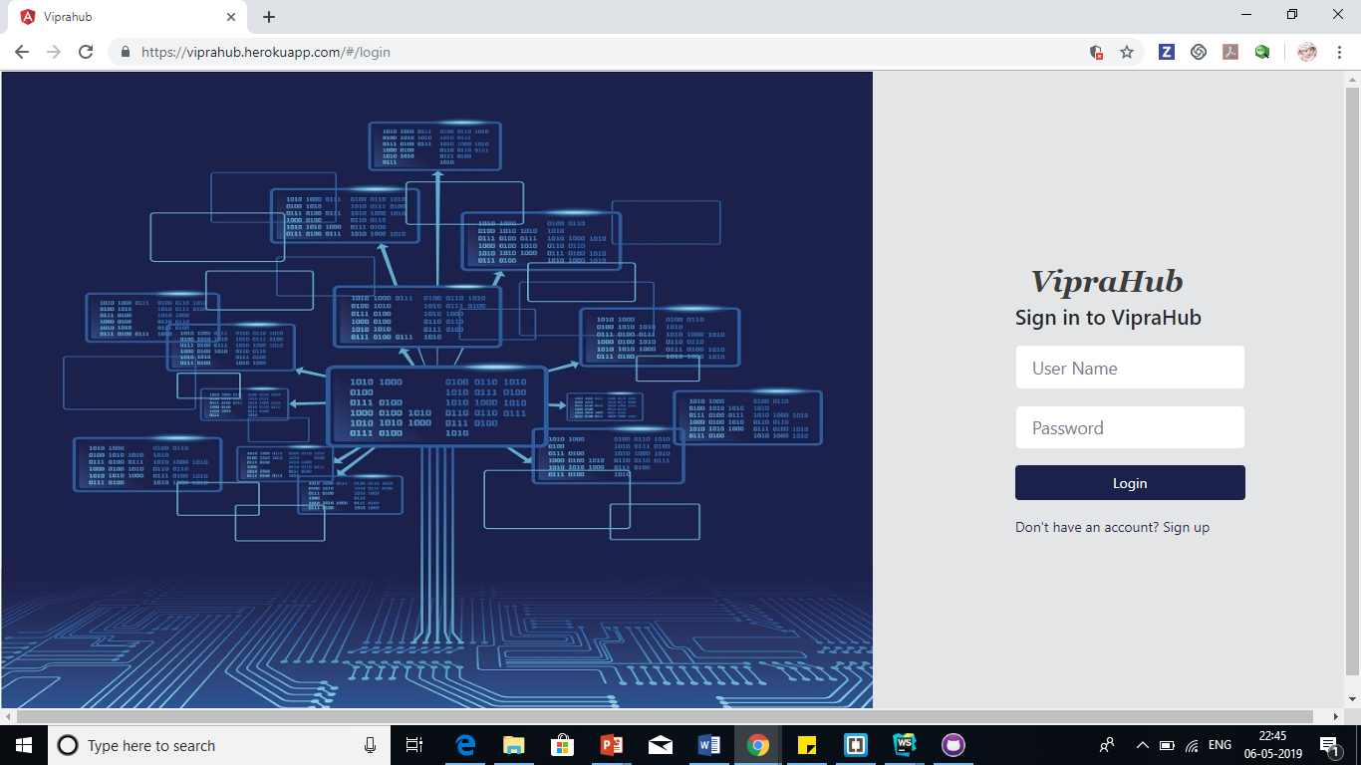
Home Page

Slide 17
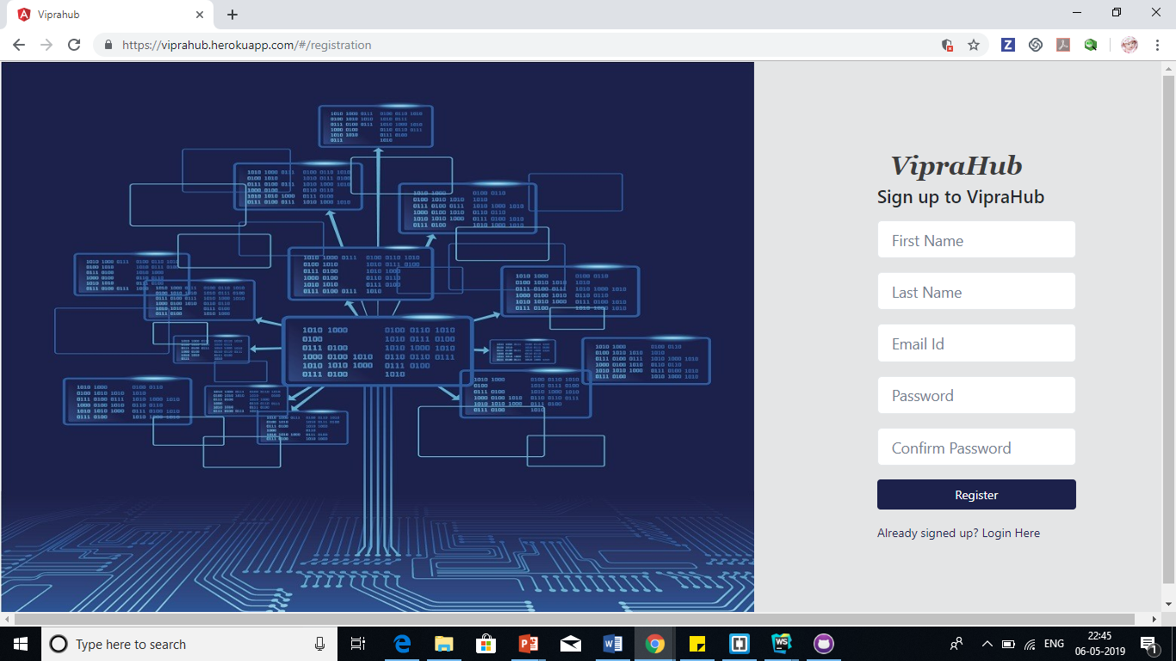
Home Page

Slide 18
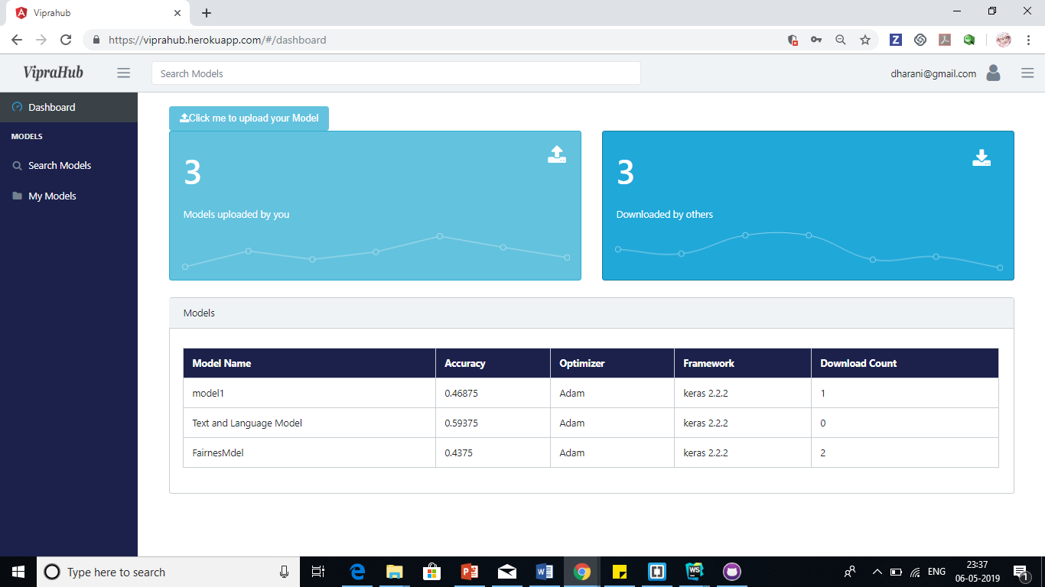
Home Page

Slide 19
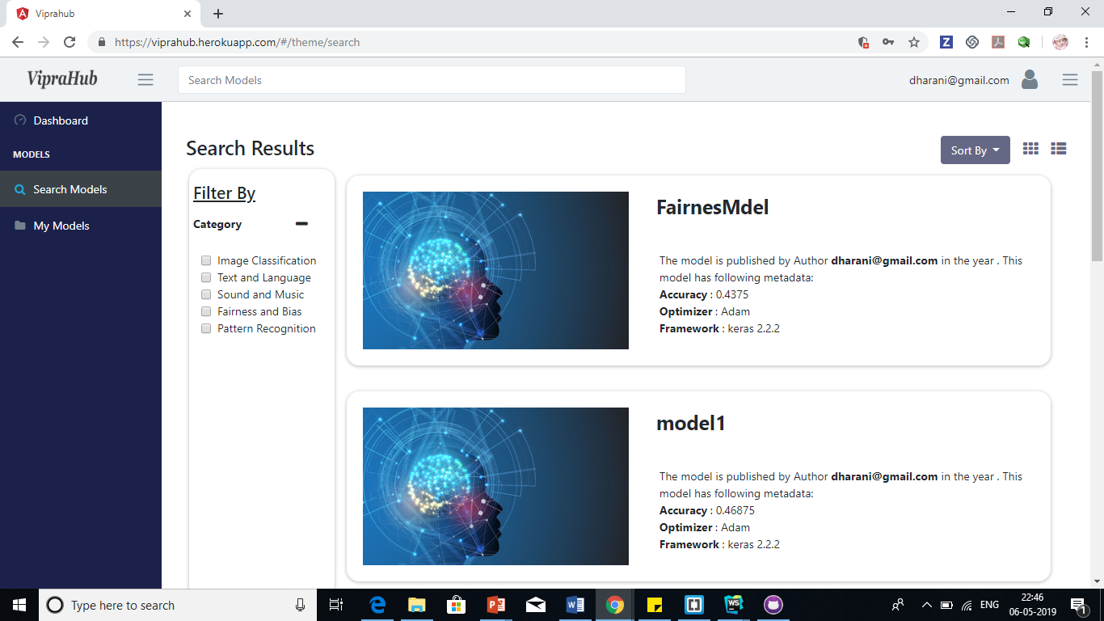
Home Page

Slide 20
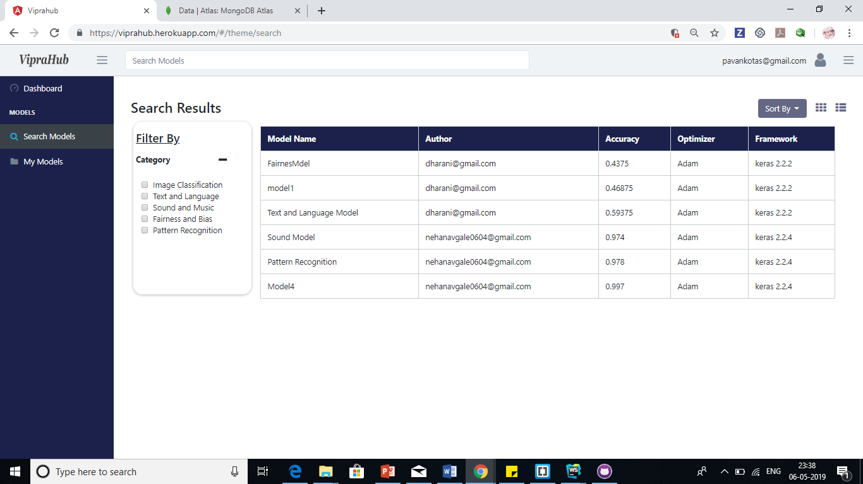
Home Page

Slide 21
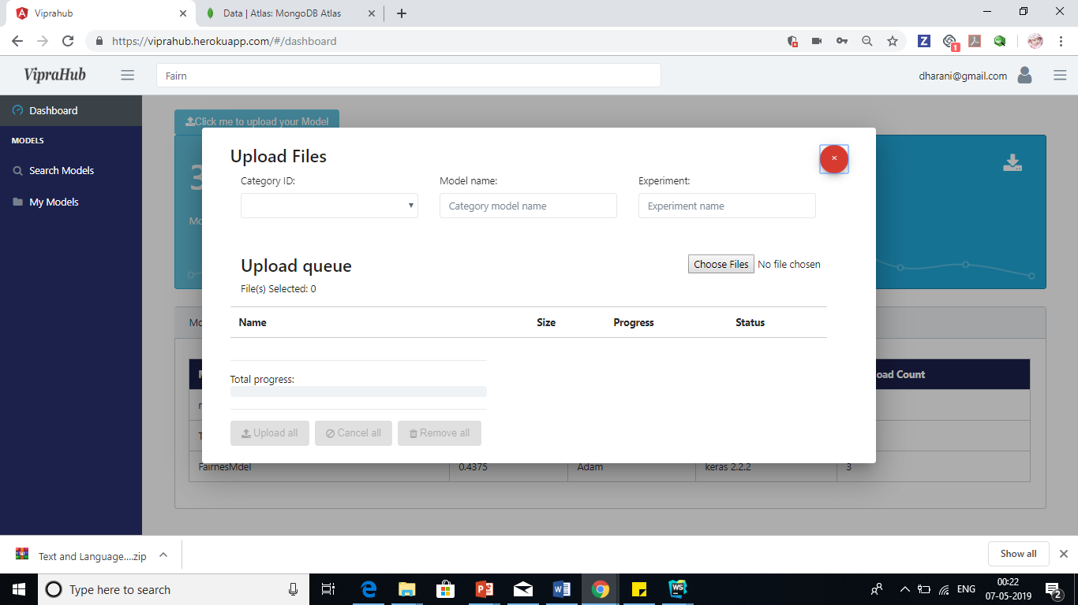
Home Page

Slide 22
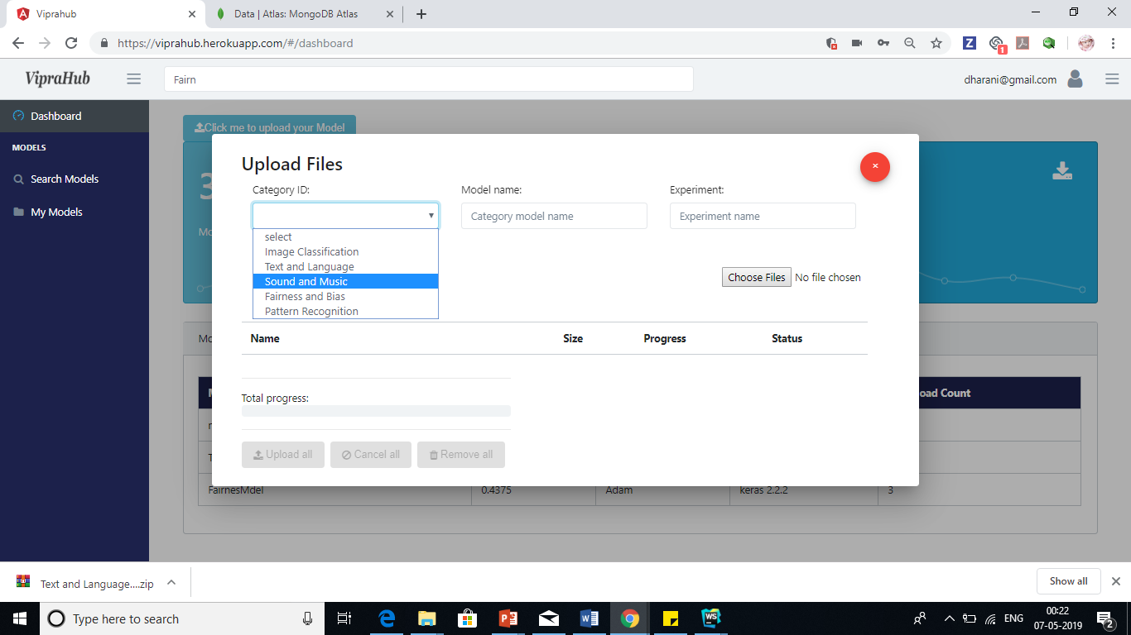
Home Page

Slide 23
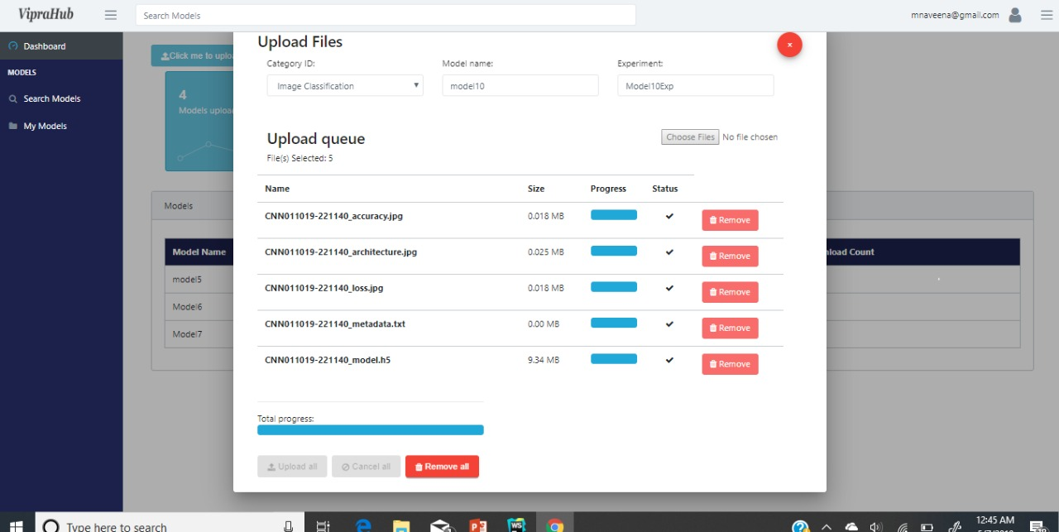
Home Page

Slide 24
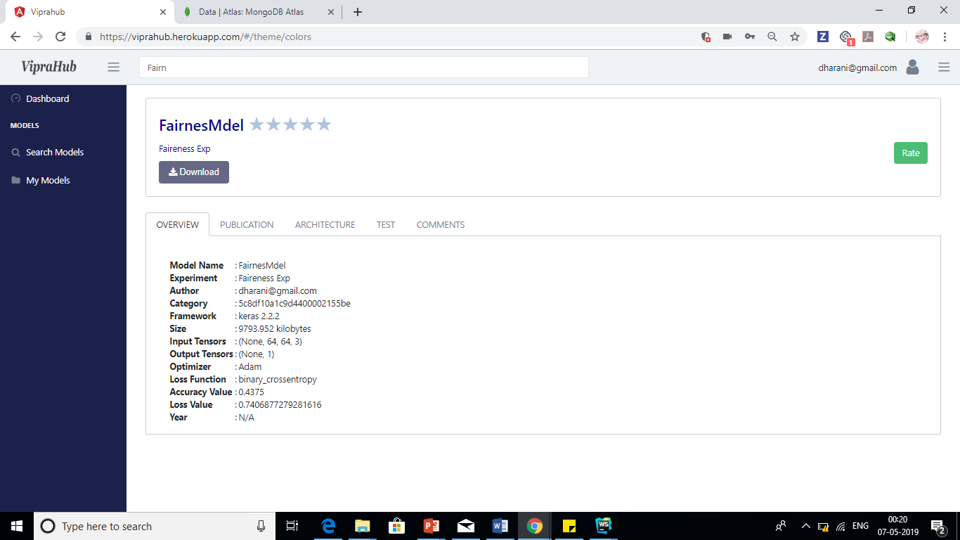
Home Page

Slide 25
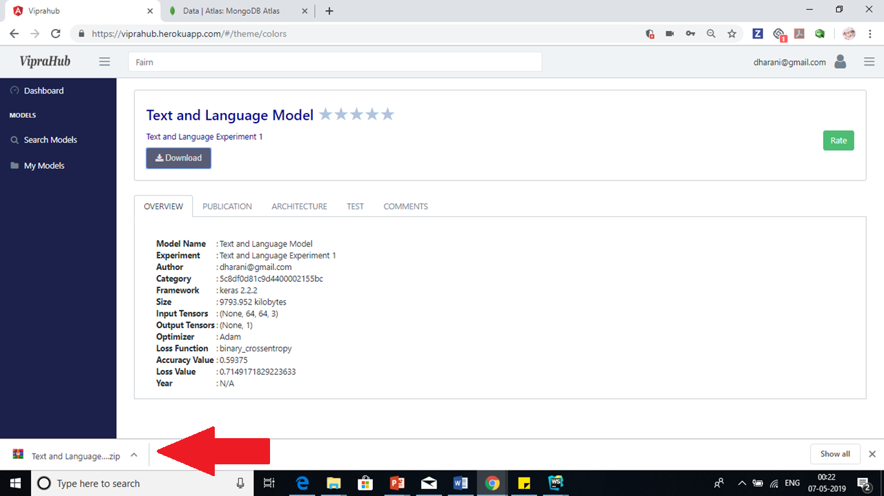
Home Page

Slide 26
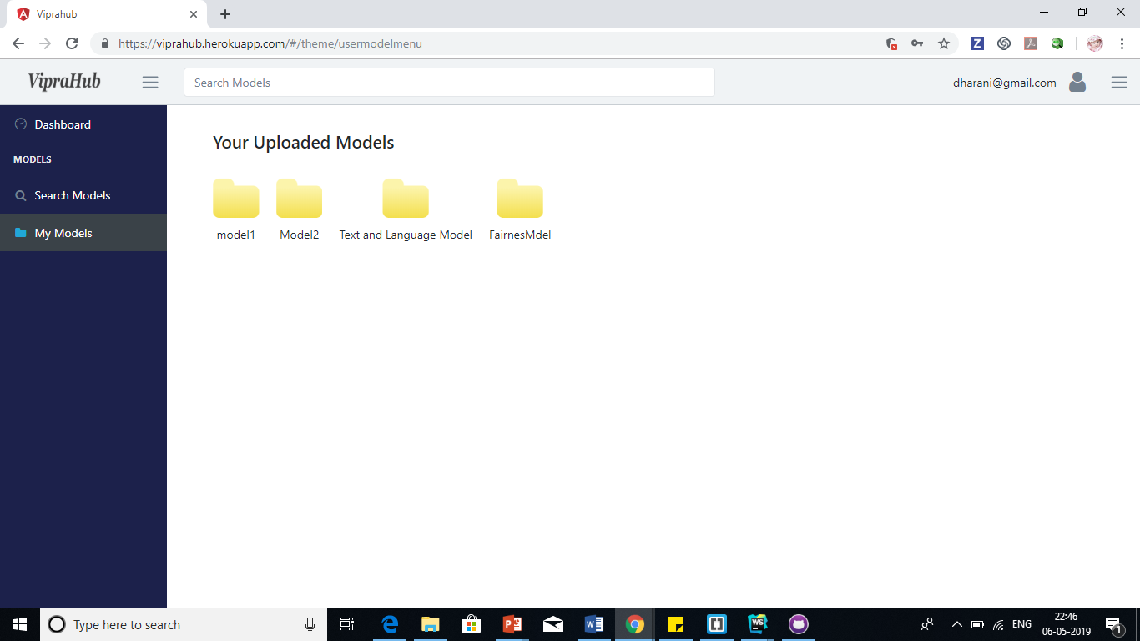
Home Page

Slide 27
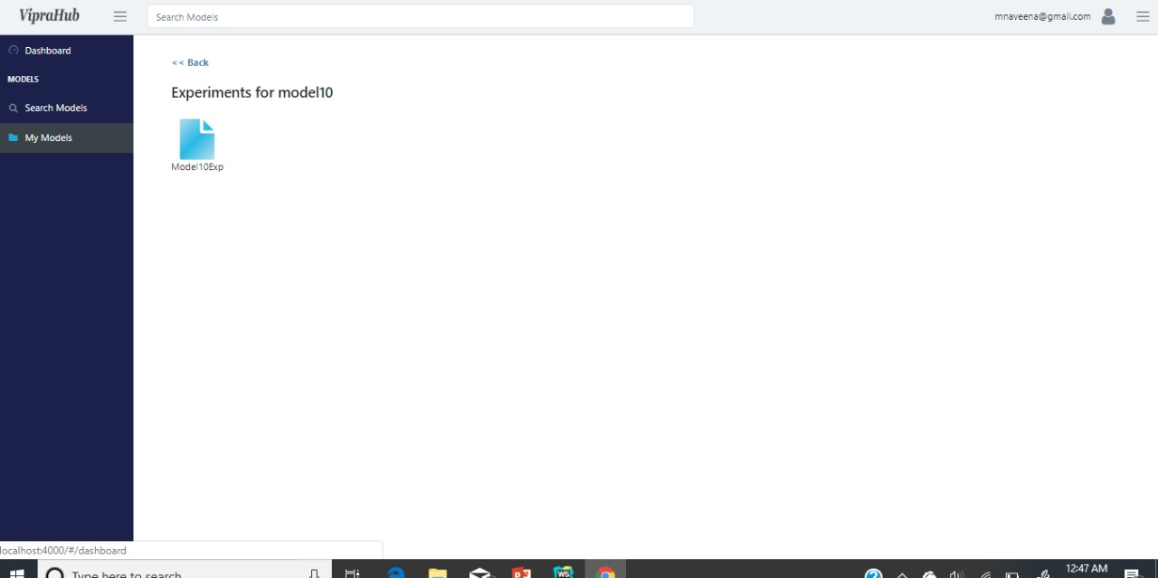
Home Page

Slide 28
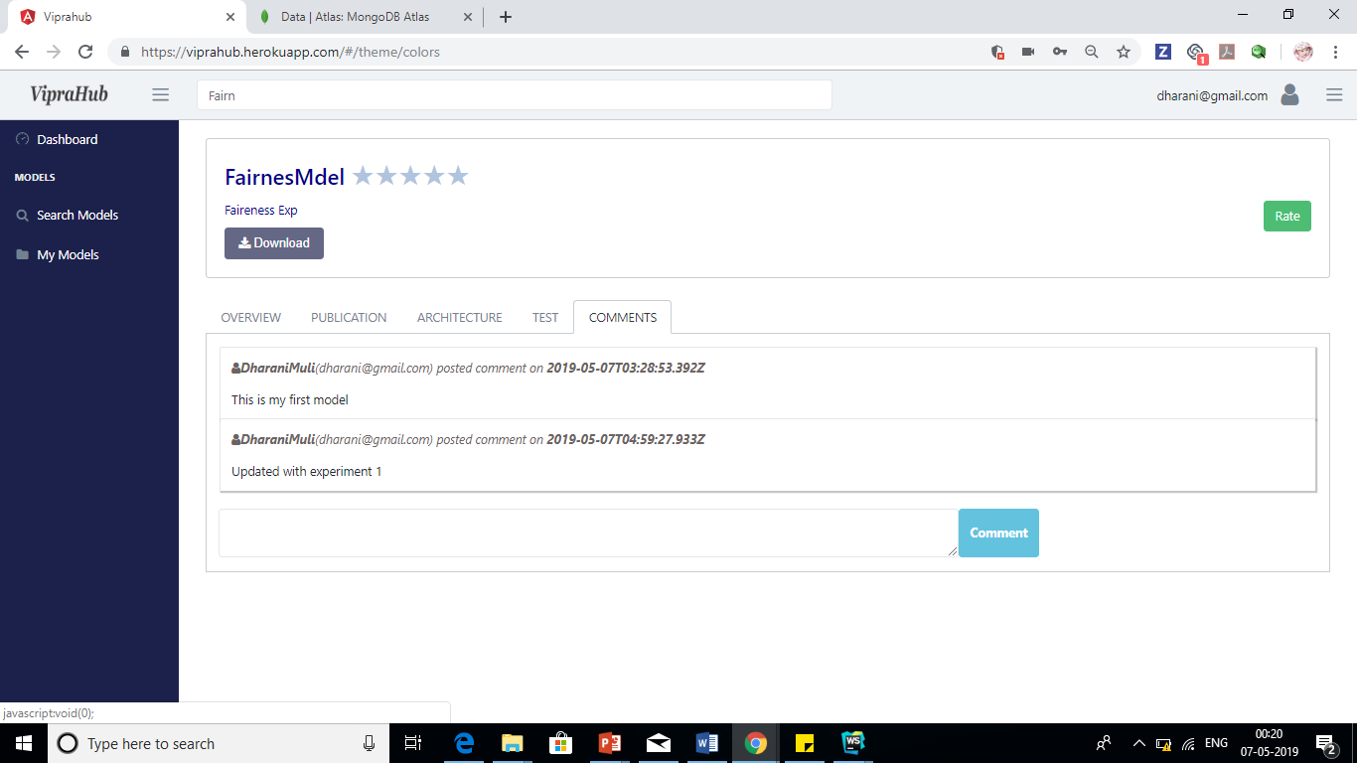
Home Page

Slide 29
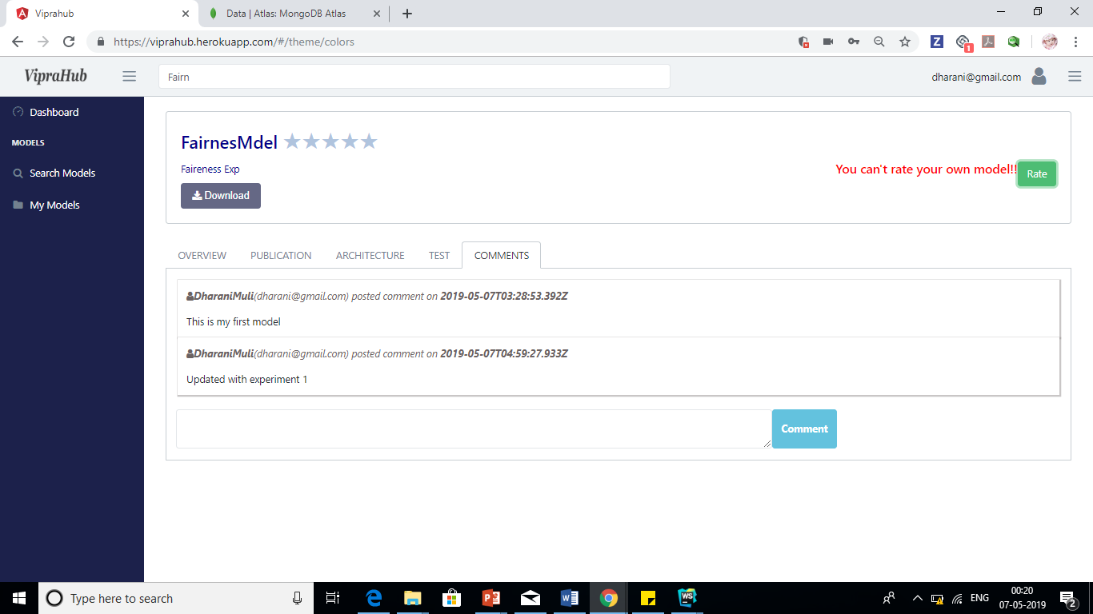
Home Page

Slide 30
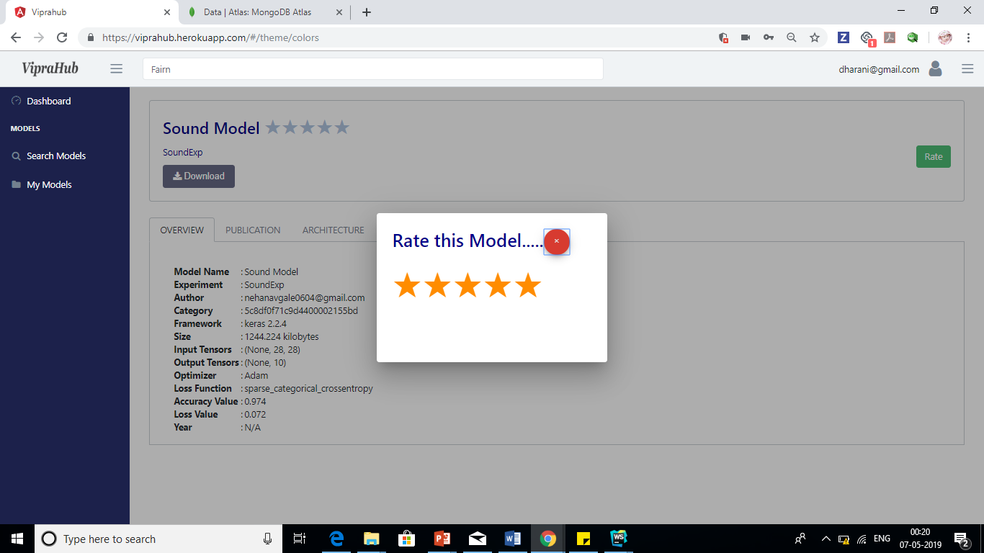
Home Page

Slide 31
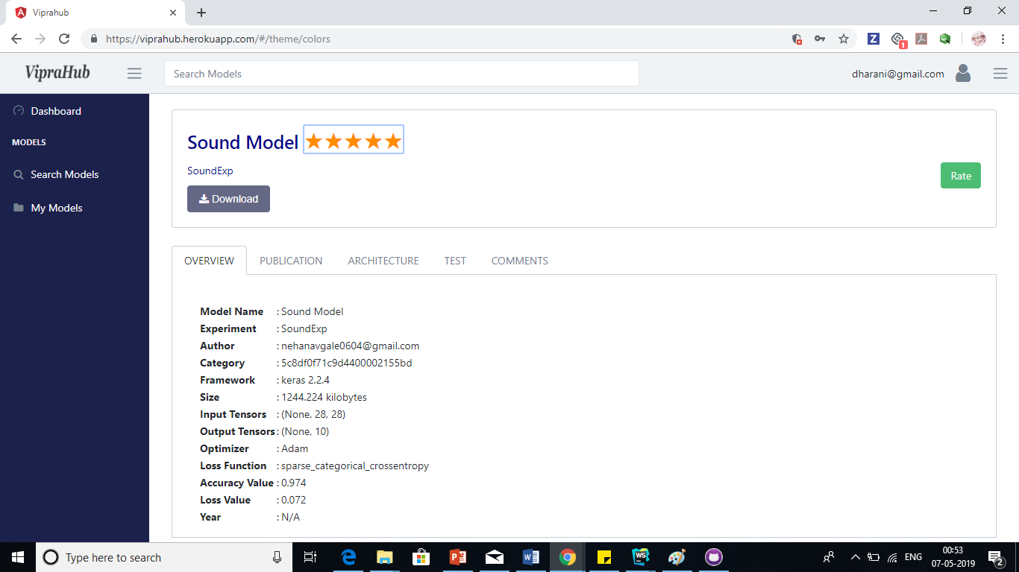
Home Page

Slide 32
VipraHub
Thank you

